Slide 1


STRATEGIC BUSINESS PLAN
MediApp: Next-Gen Healthcare Ecosystem
Building integrated medical access, delivery, teleconsultation, and hospital infrastructure for Arunachal Pradesh and Northeast India.
Target Market
Core Model
Arunachal Pradesh & NE India
Tech + Physical Healthcare Network

Slide 2






MARKET CONTEXT
Critical Healthcare Gaps in Arunachal Pradesh
Zero Doctor Visibility
Medicine Shortages
Inter-State Travel Burden
Chaotic Hospital Waiting
Patients travel blind without knowing doctor availability or specialties.
Unpredictable drug supply forces long, fruitless pharmacy hunts.
Patients forced to spend heavily traveling to metro cities for basic tests.
Hours wasted in hospital queues with zero wait-time estimates.

Slide 3






THE MEDIAPP PLATFORM
Complete Healthcare Solutions Portfolio
Live Doctor & Pharmacy Tracking
Doorstep Medicine Delivery
Real-time presence, specialty tracking, and stock visibility.
Direct fulfillment from central stock and local pharmacy partners.
Teleconsultation & Queuing
Franchise Hospital Upgrades
Encrypted video consultations and dynamic wait-time calculation.
Asset-light equipment upgrades and specialist onboarding.

Slide 4
STRATEGIC POSITIONING
Competitive Landscape Advantage
Feature / Domain | MediApp | Practo | Apollo 24/7
Focus Region | Arunachal Pradesh & NE India | National Tier 1 / Tier 2 | National Metros
Doctor Live Availability | Real-Time Location Tracking | Static Appointments Only | In-House Doctors Only
Home Visits | Home-to-Home Local Doctors | Not Supported | Not Supported
Hospital Infrastructure Model | Franchise Equipment Partner | Pure Software Listing | Owned Hospitals Only

Slide 5


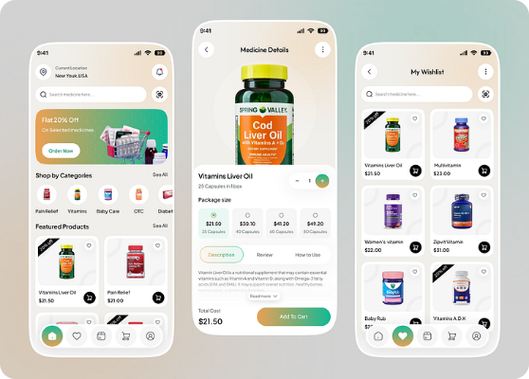
CORE MODULE 01 & 02
Live Doctor Tracking & Express Medicine Delivery
Live Doctor Location & Status
Displays active hospital presence, room status, and experience for complete transparency.
Real-Time Drug Availability
Locates specific medications across local drug houses and suggests cheaper safe alternatives.
Hybrid Delivery Model
Fulfilled via central warehouse stock and rapid delivery from partnered local retail shops.

Slide 6



CORE MODULE 03
Diet & Health Plan (Membership Business)
Personalized Wellness
Tailored diet charts based on body parameters, lifestyle, and health targets.
PREMIUM REVENUE ENGINE
₹20k - ₹30k
Local Gym & Trainer Integration
Partnerships with regional fitness centers to drive trainer income and app stickiness.
Annual subscription pricing covering customized diet, gym passes, and dedicated trainer guidance.
High-Margin Business Unit
Net profit retained after paying trainer fees (₹6k–10k) and partner gym fees (₹4k–7k).

Slide 7

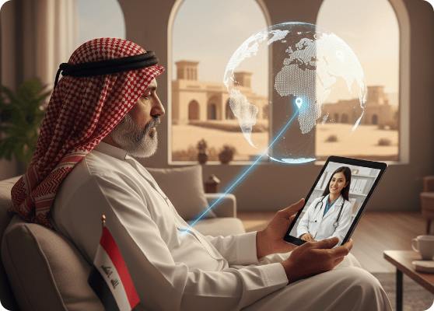


CORE MODULE 04 & 05
Smart Appointment Queuing & Teleconsultations
Smart Wait-Time Formula
Estimated Wait = (Patients Ahead) × 7 mins.
Eliminates hospital overcrowding by keeping patients informed at home.
Encrypted Video & Chat
In-app video consultations built in compliance with India's Telemedicine Guidelines 2020.
Automated Booking Fees
Flat ₹50 platform service fee per appointment and consultation booked.

Slide 8
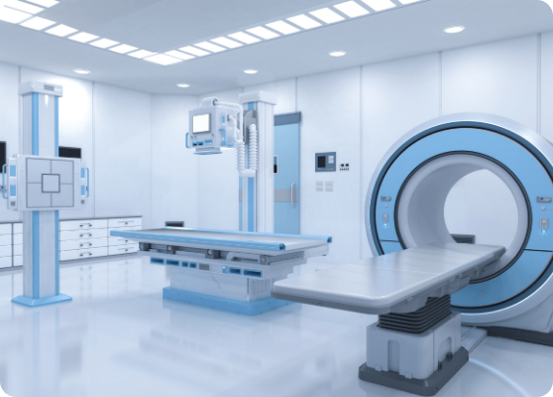
CORE MODULE 06
Hospital Franchise & Equipment Network
Asset-Light Facility Upgrades
Upgrading existing hospitals with advanced diagnostic machinery instead of building from scratch.
Tiered Technology Placement
High-end diagnostic gear in capital hubs; essential machines placed in rural centers.
Regional Expansion Path
Scaling from Arunachal → Nagaland → Mizoram → Rest of Northeast India.

Slide 9


COMMUNITY IMPACT
MediApp Foundation & Emergency Fundraisers
100% Transparent Surgery Crowdfunding
0%
Direct verification and fundraising for low-income patients requiring emergency surgeries, backed by public video stories.
Fee Before Target
Zero Profit Margin Pre-Target
MediApp Health Fund
Organic Brand Growth
100% of initial donations go directly toward hospital and medical expenses.
Surplus donations fund future emergency treatments for underprivileged patients.
Builds immense public trust and local goodwill, drastically cutting marketing acquisition costs.

Slide 10
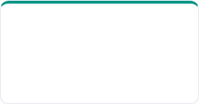


CORE MODULE 07
Partner-Based Diagnostic & Lab Workflow
STEP 01
STEP 02
STEP 03
STEP 04
App Booking
Lab Dispatch
Digital Upload
Doctor Forward
Patient books diagnostic test on MediApp.
Partner lab technician collects home sample.
Report automatically syncs to patient app profile.
Instant report sharing with treating specialist.

Slide 11

REVENUE STREAMS
Monetization Engine Summary
Platform Commissions
Diet Memberships
B2B & Franchises
₹50 per consultation + 10-25% diagnostic commission + delivery surcharges.
High-margin ₹20,000–₹30,000 annual plans bundled with trainer access.
Machine usage fees, sponsored listings, and hospital franchise royalties.

Slide 12

THE VISION
Transforming Northeast India's Healthcare Delivery
Connecting patients, doctors, pharmacies, and hospitals into one seamless, accessible infrastructure.

Slide 13



Image Sources
https://cdn.dribbble.com/userupload/48822245/file/f4660a65643bc464b88a8b75bb0b43dd.png?resize=752x&vertical=center
Source: dribbble.com
https://www.vrhhealthcare.com/_next/image?url=%2Fassets%2Fhero-telemedicine.png&w=3840&q=75
Source: www.vrhhealthcare.com
https://files.alphasophia.com/lp/b2f6362f-1d65-41ff-adcf-74dc96401b80.png
Source: www.alphasophia.com

